Slide 1
Final Project Midterm Proposal
Kiva Loor

Slide 2
Web Specs
Purpose:
The purpose of my website is to serve as an ecommerce store for a clothing company. The frontend of my site will include all the features a working ecommerce website requires, presenting all features an easily navigable manner.
Goals:
The overarching goal of my site is to fork out from a typical ecommerce site and implement features that add a layer of creativity without overcomplicating the site. Smaller goals I wish to achieve are to add interactive features and implement cross-digital media content such as animation and

Slide 3
Web Specs
Purpose:
The purpose of my website is to serve as an ecommerce store for a clothing company. The frontend of my site will include all the features a working ecommerce website requires, presenting all features an easily navigable manner.
Goals:
The overarching goal of my site is to fork out from a typical ecommerce site and implement features that add a layer of creativity without overcomplicating the site. Smaller goals I wish to achieve are to add interactive features and implement cross-digital media content such as animation and

Slide 4
Web Specs
Website Content:
Homepage
“Collection” page
“Products” page
“About” page
“Gallery” page
“Cart” page
“Checkout” page

Slide 5
UX Sitemap

Slide 6
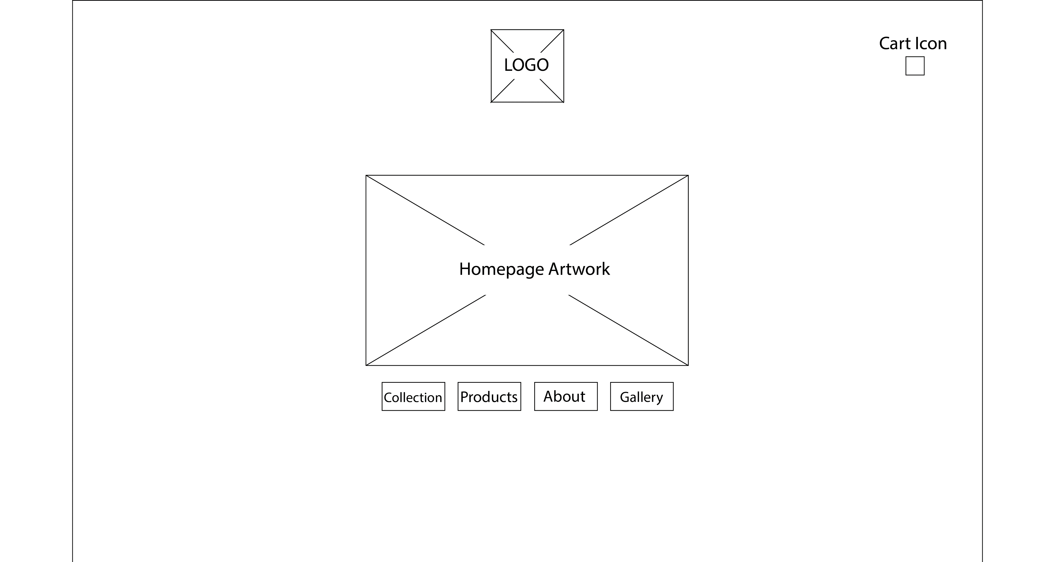
UX: Homepage Wireframe

Slide 7
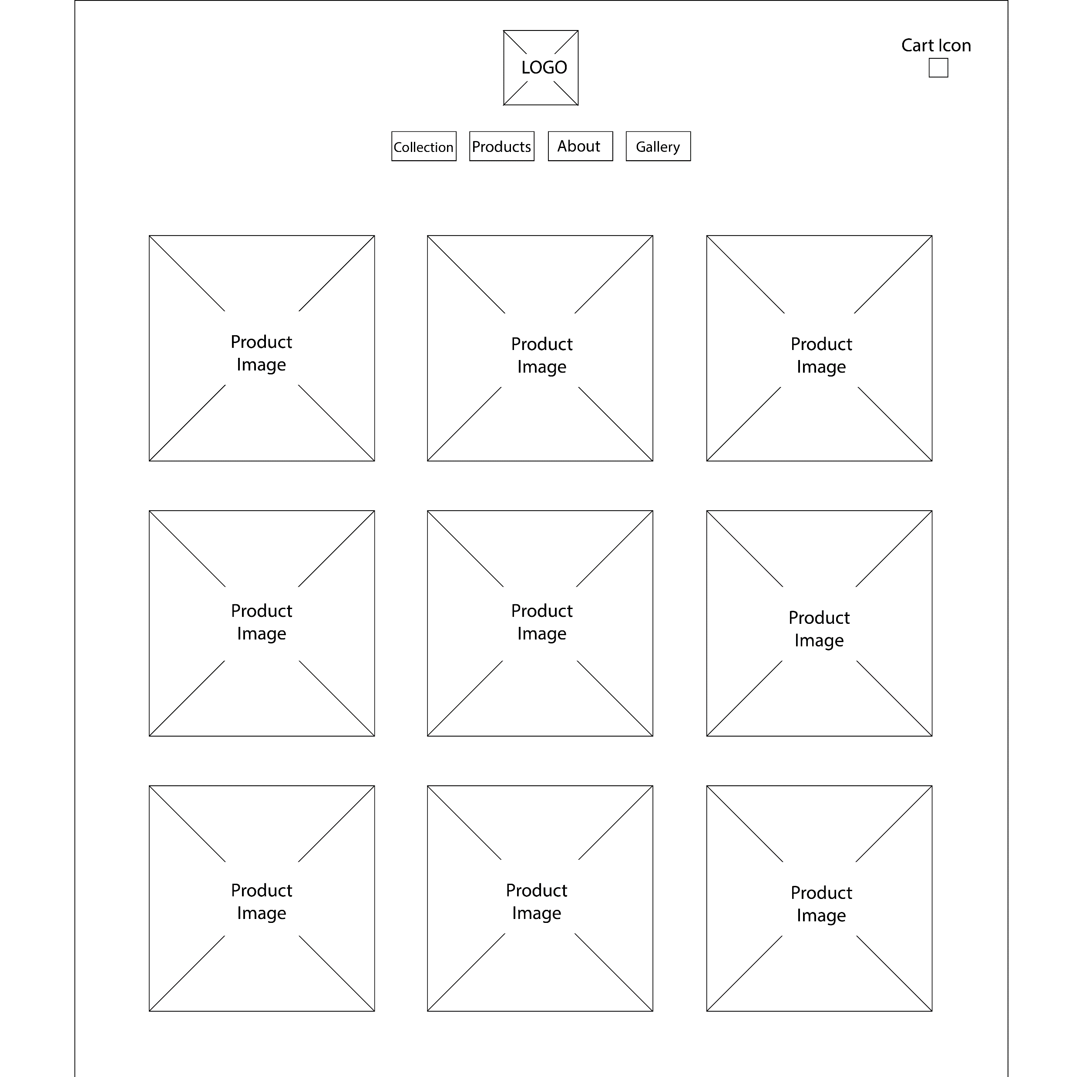
UX: Secondary Wireframes
Collection Wireframe

Slide 8
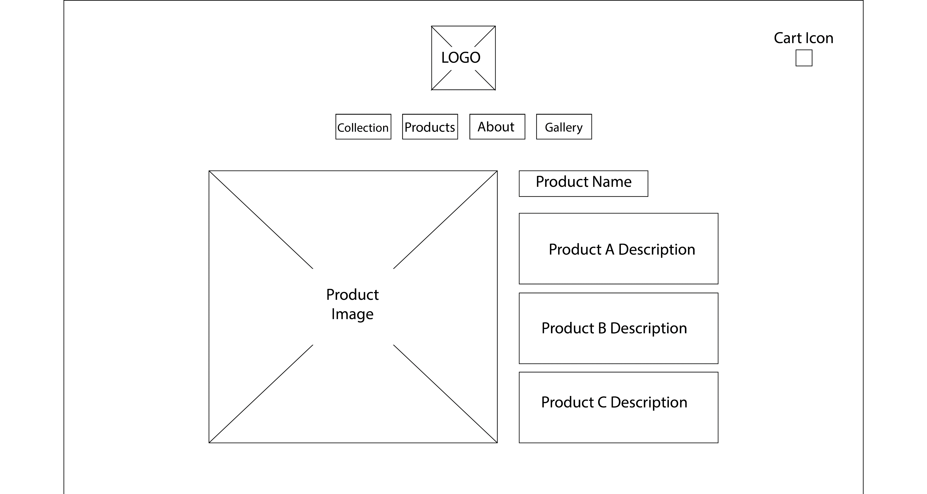
UX: Secondary Wireframes
Collection Product
Wireframe

Slide 9
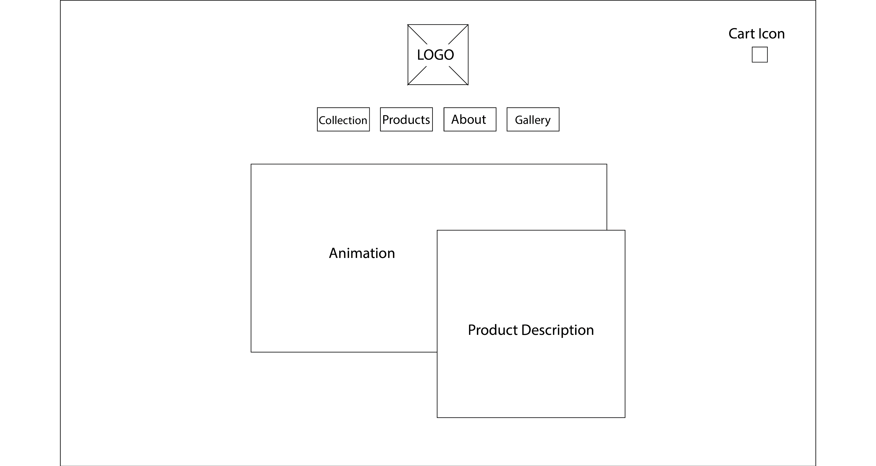
UX: Secondary Wireframes
Products Wireframe

Slide 10
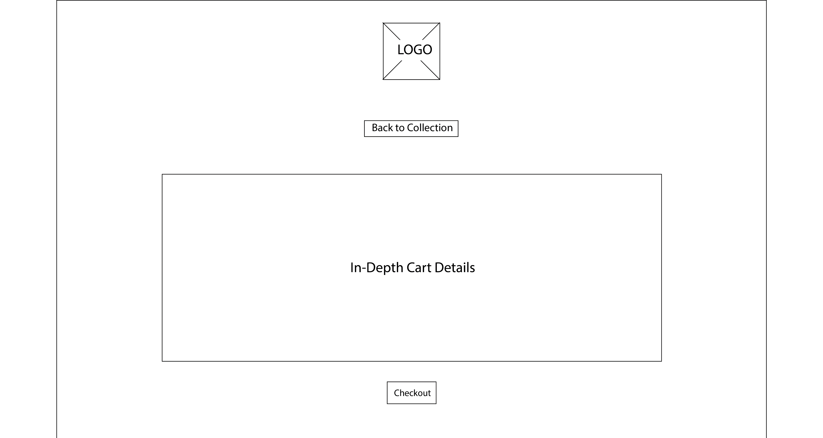
UX: Secondary Wireframes
Cart Wireframe

Slide 11
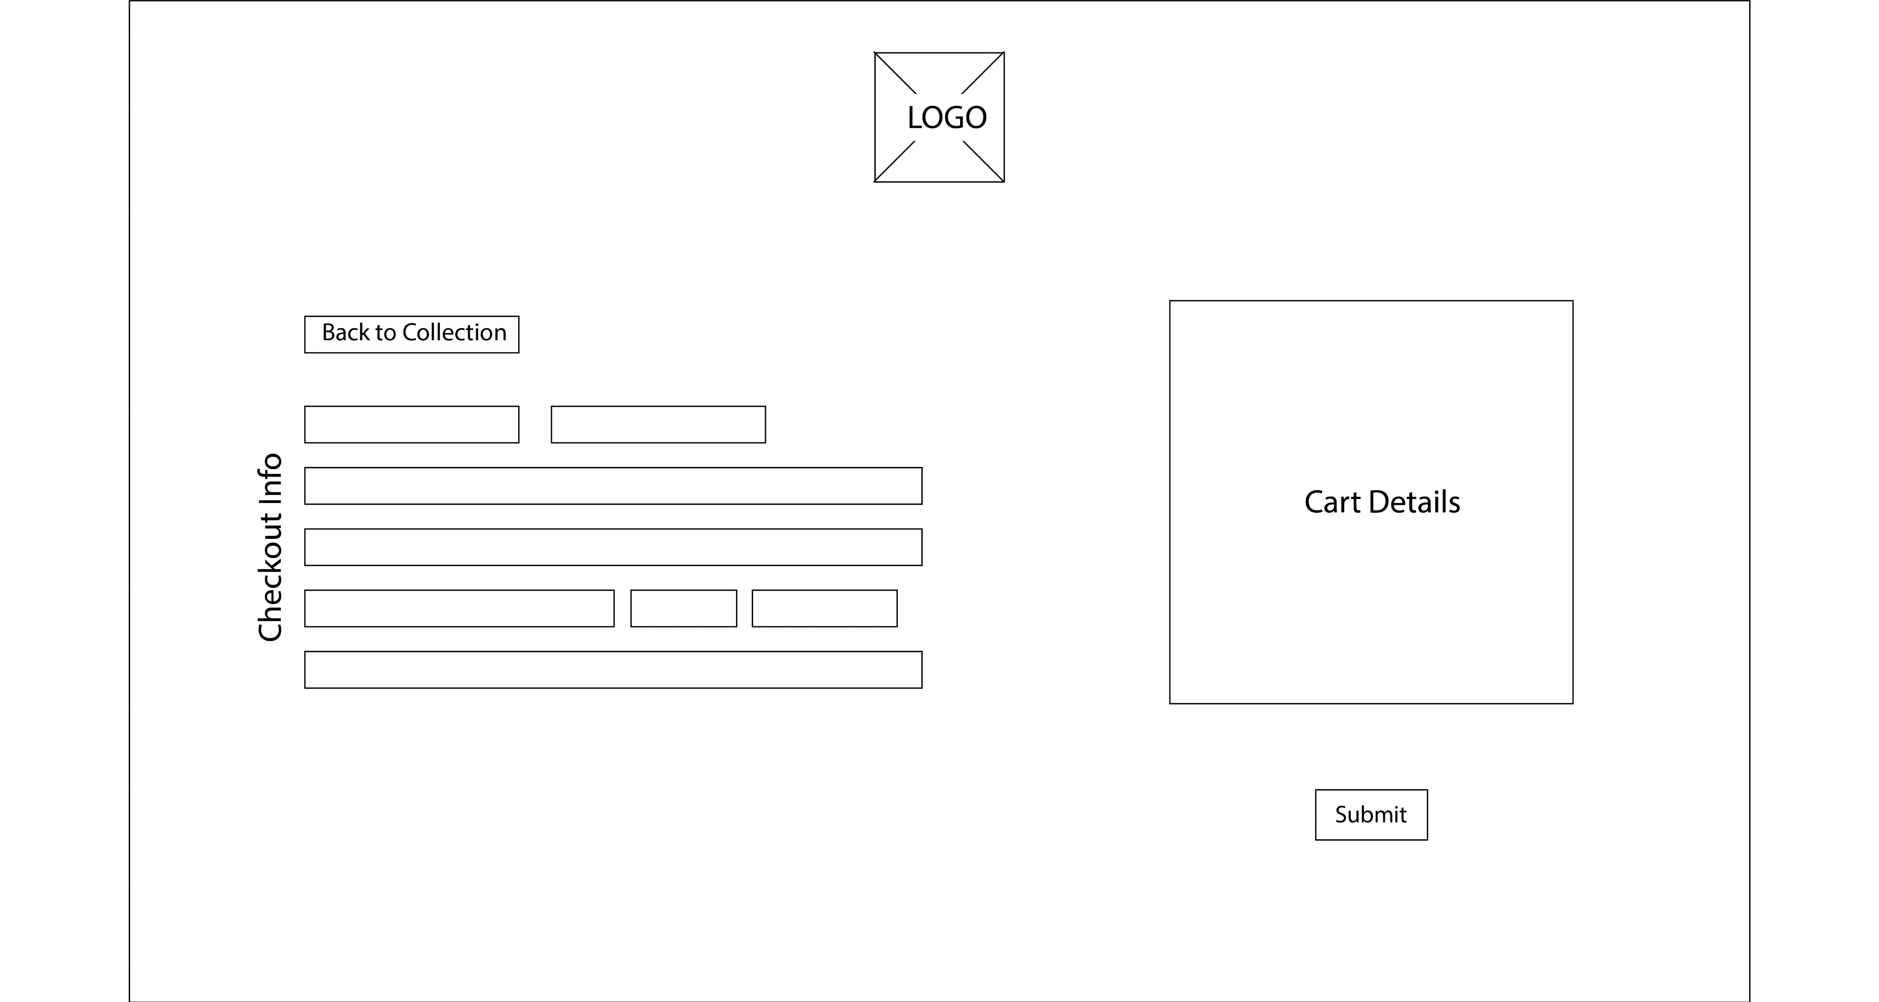
UX: Secondary Wireframes
Checkout Wireframe

Slide 12
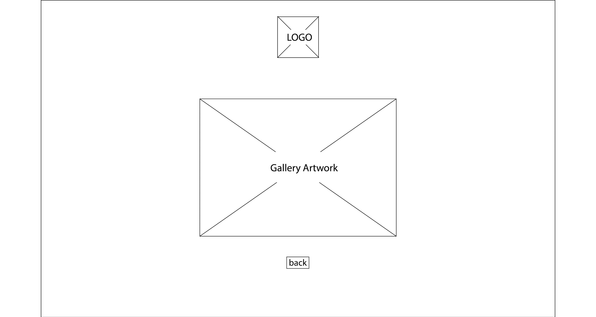
UX: Secondary Wireframes
Gallery Wireframe

Slide 13
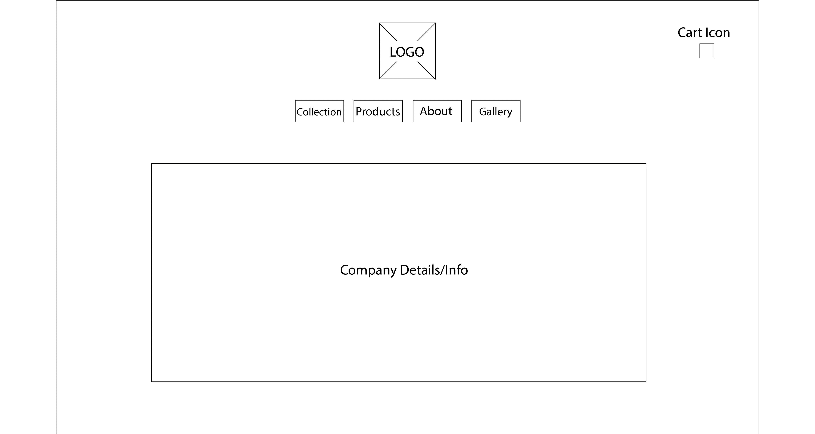
UX: Secondary Wireframes
About Wireframe

Slide 14
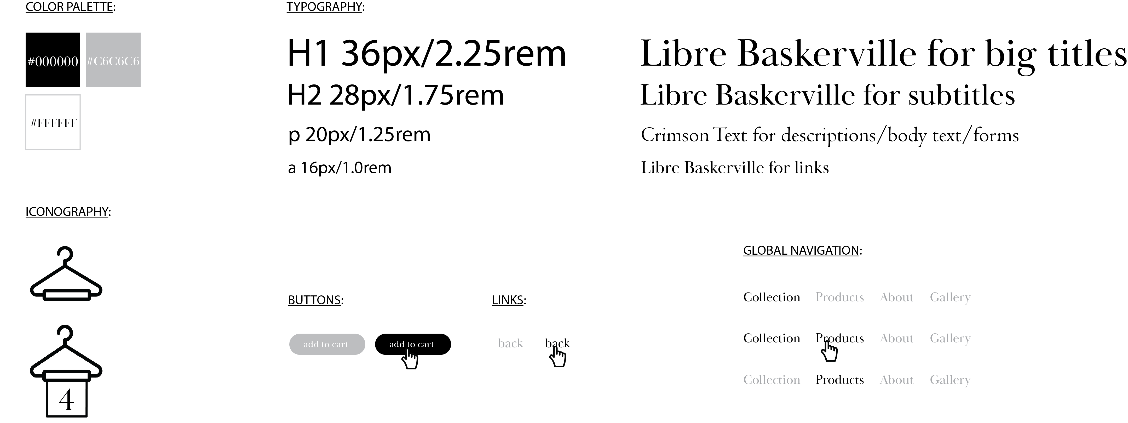
Website Syling

Slide 15
Moodboard

